Slide 1
Employee Data Analysis using Excel
STUDENT NAME: M MOHAMED HASAN
REGISTER NO: 312213379 And asunm1455312213379
DEPARTMENT:B.COM( GENERAL )
COLLEGE:TAGORE COLLEGE OF ARTS AND SCIENCE CHROMPET CHENNAI -44

Slide 2
PROJECT TITLE
Employee Performance Analysis using Excel

Slide 3


AGENDA
Problem Statement
Project Overview
End Users
Our Solution and Proposition
Dataset Description
Modelling Approach
Results and Discussion
Conclusion
3/21/2024 Annual Review

Slide 4

PROBLEM STATEMENT
As an HR Manager, I need to analyse the performance of employees in our organisation to identify the top performers, areas for improvement,and trends in performance overtime . I have access employee data,

Slide 5

PROJECT OVERVIEW
.
To analyse employees performance data using Excel and provide insights to inform talent development programs, improve team performance,and enhance the overall employee experience

Slide 6

WHO ARE THE END USERS?
HR Manager, Supervisor Department heads Operation manager Business analyst

Slide 7

OUR SOLUTION AND ITS VALUE PROPOSITION
Solutions: Collect and clean Create a customizable excel Analyse performance identify top performance development recommendations for improvement

Slide 8
Dataset Description
This date set contains employee performance data for (company name) employees, collected over a period of (time frame). The data includes: 1.Employee id 2.Name 3.Department 4.Job title Performance rating

Slide 9

THE "WOW" IN OUR SOLUTION
The main feature is identify top performance
3/21/2024 Annual Review
9

Slide 10
MODELLING
1. Descriptive analytics 2. Inferential analytics 3. Predictive analytics 4. Correlation analytics 5. Regression analytics
10

Slide 11
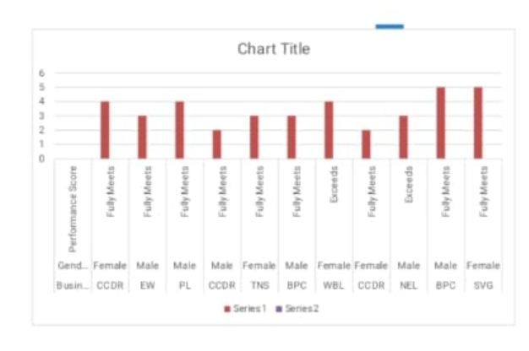
RESULTS
11

Slide 12
conclusion
This employee performance analysis using Excel has provided valuable insights into the relationship between performance ratings, sales target, employee satisfaction,and other key metrics.the findings suggest that :

